Slide 1
Homework Problems
-4. Generate the row vector a=[1 2 3 4 5] using the colon operator. Then create column vector b, from a, that has the same components as vector a, but with the elements stored in reverse order.
-3. Finish writing and testing the function started in the lecture notes, which finds two arrays of numbers from their sums and products.
-2. Solve the following system of linear equations in Matlab:
2x + y = 3
x - y = 3
(Hint: This involves creating a matrix and a vector and applying some operation, such as matrix inverse (using function inv) or matrix division (operators \ or /). Check your answer against a pencil-and-paper solution.
-1.Generate 10 seconds of a sine wave between times -1 sec. And 9 sec. Its frequency should be 0.5 Hz, and the sine wave should have a phase offset of 68 degrees. Set the sample rate to 20 Hz. Plot this function.
0.Quadratic forms are very useful in signal processing and other endeavors. A matrix quadratic term has the form:
a’Ra
where the apostrophe denotes transpose (actually the Hermitian transpose), a is a vector and R is a square matrix.
Create a square 5X5 matrix R and a 5X1 vector a, and verify that the above operation generates a scalar.

Slide 2
Homework Problems (Con’t)
1.Create a function which produces an addition reference table (as might be used by an elementary school student). To help the smart 1st graders, employ input arguments in the function to specify the values, across the top and down the sides of the table, to be summed. Test the function, and use it to create a table for at least the following inputs:
  a) Across the top: All integers 0-9
  Down the Side: The same
  b) Across the top: Every even integer from 10 through 25
  Down the Side: Every odd integer from 0 through 30
Hint: Use the meshgrid command
2.Do the same as in Problem 1, with the following exceptions:
  A. Generate a MULTIPLICATION table
  B. Rather than print the output table, the table should be output as a 2-dimensional output array.
  C. Use functions tic and toc to measure the execution times for different cases you generate (and note the total execution times and execution times per output product).
3.Generate a function which calculates the mean of the non-zero elements of an input variable. Following the usual MATLAB convention, operate on each column of a 2-D input array separately (which should produce a row vector of output means). For row or column vectors, the scalar valued output should be the mean of all the non-zero elements of the input. Hint: Set up the calling sequence format similar to that of the MATLAB “mean” command. Also, draw some of your inspiration for calculating the results from the asset allocation example.
4.Modify the bit detection example in the ways mentioned below. (This exercise will simulate a communications signal running at one-tenth the original speed. When you are done, you can decide whether the bit detections process is more or less resistant to noise.)
  A. The noise should have a std. Deviation of 1.0
  B. Each bit lasts for 10 voltage samples instead of the original 1 sample per bit. (To do this, you must replicate each voltage sample by a factor of 10 before adding independent noise to each sample.)
  C. Prior to the detection process, average together each 10 consecutive noisy voltage samples.
Observe what happens to the bit error rate after the bits per sample has been increased
What do you think will happen if the bit detections are misaligned with the bit boundaries?
+ | 2 | 4 | 6
1 | 3 | 5 | 7
2 | 4 | 6 | 8
3 | 5 | 7 | 9
Generate
random bit
pattern
Convert
to bipolar
Voltage
samples
Replicate
Each sample
10X
Add noise
to each
sample
Avg.
Each 10 noisy
samples
Bit
Detection
BER
Est.

Slide 3
Homework Problems
Continued
5. Modify the function nz_mean to compute the sum of non-zero values of an array. The new function should compute the means of the positive and negative elements separately and output both results. Treat the zero-valued elements as positive.
6. Create a Matlab function to calculate a single Fibbonacci number using the recursion below. The function input/output format should be something like:
f = fibbo(n)
where n is the index into the series, and f is the (integer) Fibbonacci number having that index.
The recursion definition is:
f(1) = 1
f(2) = 1
f(k) = f(k-1) + f(k-2); for all k>2
(The series is undefined for negative indices)
You may implement the recursion with “for” loops. If you were once a computer scientist, and you feel up to it, you may implement the function with recursive function calls. (You would then probably need another argument in the input argument list to keep track of the depth of recursion. )
7. You can create order from chaos. Write a Matlab script or function that maps an (x,y) location at some iteration n and maps it to new location at the next iteration (n+1). The mapping is defined by the formula:
(x_{n+1},y_{n+1}) = (rx_{n}cosA-sy_{n}sinB+h, rx_{n}sinA+sy_{n}cosB+k ), for n>1
(x₁,y₁) = (0 ,0)
The random part of this process comes from the way the parameter set {A,B,r,s,h,k} can take any one of four values in a given iteration n, with certain probabilities:

Slide 4
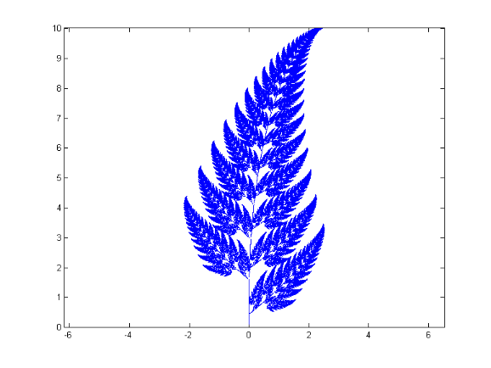
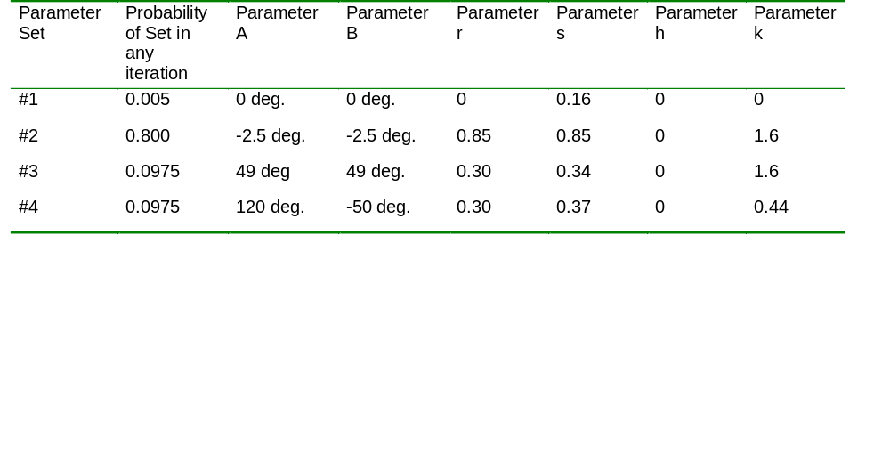
Homework Problems
Continued
(7 Continued)
Thus, for example iteration 10 might use Parameter Set #1 by chance, followed by Parameter Set #4 (again by chance) for iteration 11.
Run this scheme for several thousand iterations and plot the positions of all the points (x_{n},y_{n}) to get a nice picture. (Note: when you plot the positions use unconnected dots as markers. If you inadvertently plot the results using connection lines (the default), the plot will resemble an industrial accident at the Prince spaghetti factory.)

Slide 5
Homework Problems, Continued
8. The MATLAB function hanning is sometimes used as a starting point for filter design. Plot the magnitude and phase responses of a 25-point Hanning window as subplots on the same page (i.e.. figure). The magnitude and phase responses are the magnitude and phase of the FFT of the window, respectively. To increase response detail, make the plots with a 1024-point FFT. (As always, you can freely utilize the help utilities to learn how to use any MATLAB function.) Would you say this window function is a high-pass or low-pass filter?
9.Create the following signals and convolve them with the 25-point Hanning window from Problem 2. Plot, in each case, the original signal, its FFT magnitude, the filtered (i.e.. convolved) output, and its FFT magnitude.
  A. A train of unit pulses with 25 sample spacing
  B. A square wave with 50% duty cycle and an 8 sample period
  C. A sine wave with a period of 8 samples
  D. A sine wave with a period of 48 samples
  E. A sequence of unit variance, zero mean white Gaussian nose samples.
(All sequences should be at least 256 samples long)

Slide 6
Homework, Continued
10. The code below provides an outline in MATLAB-like language or a simplified form of the [in]famous CIDF algorithm. Unfortunately, the outline does not take any advantage of the vectorization afforded by MATLAB. Vectorize this code and produce a working MATLAB function.
Function [max_corr, df_azimuth] = simple_cidf( meas_vect, dbase, az_list )
% meas_vect = A [num_antX1] measure vector
%dbase = A [num_antXnum_dbase_vectors] array containing all the database vectors
%az_list = The list of azimuths associated with the database vectors (az_list will have length num_dbase_vectors)
%max_corr = Maximum correlation value found
% df_azimuth = Azimuth corresponding to the peak correlation. It is the DF estimate
% Let num_dbase_vectors = Number of vectors in the database (= # azimuths represented)
% Let num_ant = Number of antennas in measurement (=measurement vector length)
for( database_index=1:num_dbase_vectors)
correlation( database_index ) = 0; % Initialize correlation value
for( antenna_index=1:num_ant )
correlation(database_index) = correlation(database_index) …
+ conj( meas_vect(antenna_index)) .* dbase(antenna_index,database_index);
end;
correlation(database_index) = abs(correlation(database_index) );
end;
% Use the “max” function to determine the following two values:
% max_corr = Maximum value of variable correlation
% max_db_index = Index of the maximum correlation value (which corresponds to the index of the best matching
% database vector
df_azimuth = az_list( max_db_index ); % DF estimate

Slide 7
Homework Problems, Continued
11. Use a Monte Carlo technique to estimate the value of Pi. The method works by constructing a unit square (1 X 1), inscribed by a circle of diameter 1:
If one generates random points uniformly distributed in the square, the proportion of points falling inside the circle (P) will be proportional to the ratio of their areas:
P = Proportion in Circle = Area of Circle / Area of square = π(0.5)² / 1² = π/4
Thus we estimate π = 4P.
Create a function to implement this technique. The function should allow the user to specify the number of noise samples to use. For aesthetic reasons, have the function plot the locations of the first 1000 data points, as well as the square and inscribed circle. When doing this experiment, see if averaging separate Monte Carlo runs helps accuracy. For example, suppose you use 2000 points in a Monte Carlo run to estimate Pi.: would you get a better estimate by averaging 10 such 2000-point runs?

Slide 8
Homework Problems, Con’t
12. The code below operates on the data using a preponderance of “for” loops. Unfortunately, the function does not take any advantage of the vectorization afforded by MATLAB. Vectorize this MATLAB function. What is the dimension of the output array c?
% SOME_FUNC - A function to operate on complex input column vector a and complex input array b to produce real-valued
% output array c.
% Note that a should have size [M X 1], and b should have size [M X N].
function c = some_func( a, b )
[M, N] = size( b );
if( size(a, 1) ~= M ) % Error checking
error( ‘a and b have incompatible dimensions’ )
end;
for( index=1:N )
c(index) = 0;
for( jdex=1:M )
c(index) = c(index) + conj( a(jdex) ) .* b( jdex, index );
end;
c(index) = abs( c(index) );
end;

Slide 9
Homework Problems, Continued
13. An exercise in addressing:
  This is inspired by a real-world example. Your aim is to ultimately reassemble an array so its rows are in correct order.
  Load MAT file homework_13_data.mat, which contains an array (indat) whos rows are permuted in a strange way:
    A. The rows are grouped into NUM_GROUPS blocks, each of size GROUP_SIZE.
    B. The groups are stored in reverse order, but within each group, the rows are in correct order.
  b. To reorder this array, start by creating an array or vector of indices, that will ultimately be used to reorder the rows of array indat. To create this indexing array in a general way, use the supplied variables num_groups and group_size.
  c. Once you have the appropriate indexing array (let’s call it row_changer, for example), use row_changer to permute the rows (but not columns) of indat. The resulting output array should contain all the intergers, in order, from 1 through num_groups*group_size*num_columns. The arrangement will be read along rows to make it easy to inspect.
  d. For extra credit, can you use group_size on the output matrix, to create a new array that is identical to indat?
14. Create a function, named repeater, which takes two input arguments: 1) a vector x containing data, and 2) a vector n containing non-negative integers. The function will return a vector y, where the i^{th} element of x, x(i), is repeated n(i) times.
For example, if x=[3 2 9 5 6] and n=[2 0 3 1 2], then the output y will be
y=[3 3 9 9 9 5 6 6]. Note that since n(2)=0, then x(2) doesn’t appear in the output.
15. Modify the meshgrid example in class to produce a conical surface.
16. Write a Matlab function that creates a vector A of alternating ones and zeros, of length 2*N. For example when N=3, then the output vector should be [1 0 1 0 1 0] (having length 6).
17. Using function rand, generate an array of random integers that are uniformly distrbuted in the closed interval [2,10] (i.e. 2 through 10, inclusive). Such a function might have a calling sequence like out=rand2_10(numrows,numcols) to generate a specific two-dimensional array. Test your function by generating a vector containing 1000 such output integers, and plotting a histogram of the results.

Slide 10
Homework Problems, Concluded
18. Write a Matlab function eqtri(a,b) which plots the graph of an equilateral triangle with two vertices at (a,a) and (b,a), and with the third vertex lying above the line segment that connects the first two vertices. Use the ‘fill’ function to paint the triangle with the color of your choice.

